Slide 1


Department of Information Science and Engineering
Department of Information Science and Engineering
Project Phase-I
Dynamic Health Risk Predictor
Project Batch and USN
NIGAM L RAJ -1NT23IS142
PRAJWAL R-1NT23IS158
S.LOKESH-1NT23IS184
SACHIN S.K-1NT23IS186
Guide Name, and Designation
Mrs.Lakshmi M,Assistant Professor
Date-07-06-26

Slide 2
Contents
Introduction
Research gaps/motivation
Literature brief
Problem Statement
Objectives
Framework /Methodology
Flowchart
Implementation
References

Slide 3
Introduction
Wearable devices, particularly smartwatches, have transformed the way physiological data is continuously monitored in real time. These devices capture essential health signals such as heart rate, heart rate variability (HRV), sleep patterns, and physical activity with high frequency and minimal user effort.
With the increasing adoption of wearable technology, there is a growing opportunity to leverage this rich, continuous data to understand an individual’s physiological state beyond traditional clinical assessments. However, raw wearable data is often noisy, highly variable, and personalized, making it challenging to extract meaningful insights directly.
This project focuses on utilizing smartwatch-derived data to model and interpret physiological states using advanced machine learning techniques. By applying preprocessing, baseline estimation, rolling statistics, and unsupervised learning models, the system aims to identify patterns, detect deviations, and infer potential health risks in a personalized manner.

Slide 4
Outcome of Literature/Research Gap/Motivation
S. NO | PAPER TITLE | ARCHITECTURE / MODEL USED | DATASETS USED | PERFORMANCE METRICS & LOSS | ADVANTAGES / CONTRIBUTIONS | LIMITATIONS
1 | Gaussian Mixture Generative Model for End-to-End Unsupervised Physiological State Identification | GMGM combining DBN encoder, GMM density estimation, and generative decoder in unified end-to-end optimization framework. | Multi-sensor wearable dataset including accelerometry features, HR, HRV, and activity classification streams from IoT devices. | Achieves 5.5% higher ROC-AUC than DAGMM; optimized using KL-divergence and likelihood-based joint objective function. | End-to-end learning, optimized latent space, fog-layer anomaly refinement, adaptive HMM with circadian priors, and reduced computation using improved Viterbi. | High computational cost; unsuitable for real-time edge deployment; decoupled approaches still used risking feature loss.
2 | Unsupervised ML for Recovery Patterns in Elite Canoe-Kayak Athletes | K-Means clustering with four physiological states derived from sleep architecture and HRV features without supervised labels. | Longitudinal elite athlete dataset including sleep duration, fragmentation, RMSSD, respiratory rate, and HRV metrics. | Explains 79% variance; evaluated using silhouette scores and physiological interpretability of clusters. | Identifies recovery states, highlights respiratory rate importance, supports personalized monitoring, reveals vagal dominance paradox. | Limited generalizability beyond athletes; lacks temporal modeling; single-sport dataset restricts broader applicability.

Slide 5
Outcome of Literature/Research Gap/Motivation
S. NO | PAPER TITLE | ARCHITECTURE / MODEL USED | DATASETS USED | PERFORMANCE METRICS & LOSS | ADVANTAGES / CONTRIBUTIONS | LIMITATIONS
3 | Hierarchical Heated Markov Modeling for Wearable Activity Data Synthesis | HHMM with three tiers: Markov activity generation, HR sampling via MCMC, and secondary feature synthesis. | Consumer wearable data with activity-conditioned Poisson sampling for irregular data generation and synthetic validation. | Maintains ergodicity and realistic long-term distributions; heating prevents excessive self-transition probabilities. | Prevents sedentary bias, models irregular sampling, generates multi-level synthetic data, useful for benchmarking ML systems. | Focuses on synthesis, not classification; high computational complexity; lacks personalization and individual baseline modeling.
4 | Predictive Modeling of Biomedical Temporal Data: Review | Review of HMM, LSTM, Transformers, CRF, and state-space models for healthcare time-series analysis. | Survey of 50+ studies using EHR, wearable, and clinical temporal datasets. | Compares AUROC, F1, and calibration; highlights performance gaps between dense and sparse data models. | Provides taxonomy, identifies irregular time-series challenge, recommends HMM for states and Transformers for dependencies. | No new model proposed; mostly EHR-focused; irregular sampling remains unresolved in many methods.

Slide 6
Literature - brief
1. Personalized Baseline Estimation Static thresholds are ineffective due to individual variability. Dynamic baselines using rolling statistics and VAE model personal “normal” behavior, enabling accurate anomaly detection based on individual physiology rather than population-level averages.
2. Limitation of Supervised Labeling Physiological states are latent and difficult to label accurately. Rule-based labeling leads to circular learning. Unsupervised methods overcome this by discovering patterns directly from data without predefined labels.
3. Clustering for State Discovery K-Means and GMM are widely used for identifying hidden physiological states. K-Means provides clear clusters, while GMM captures overlapping states, making it more suitable for real-world biological variability.

Slide 7
Literature - brief
4. Temporal Modeling using HMM HMM captures sequential transitions between physiological states over time. It models state evolution and helps track progression patterns like stress escalation and recovery using probabilistic transitions.
5. Feature Engineering Techniques Deviation features compare current values to personal baselines, while rolling trends capture temporal changes. These features improve detection of physiological shifts and help distinguish short-term fluctuations from long-term deterioration.

Slide 8
Problem Statement
"Build an intelligent system that transforms daily wearable health data into personalized physiological insights by discovering hidden health states, modelling temporal transitions, and detecting early indicators of health risk — using personal baselines rather than population-level thresholds."

Slide 9
Objectives
1. To process wearable health data and extract personalized physiological indicators through baseline estimation, deviation analysis, and rolling statistical features derived from signals such as heart rate, HRV, sleep, and activity.
2. To identify distinct physiological states from wearable signals using unsupervised learning techniques in order to represent user conditions such as recovery, baseline stability, physiological strain, and high stress.
3. To analyze the temporal progression of physiological states for each user and generate personalized health insights by modeling state transitions and behavioral patterns over time.

Slide 10
Framework/Methodology
1. Raw Signal Ingestion and Temporal Alignment
Multi-modal wearable data (HR, HRV, sleep, steps, SpO₂, BP) is ingested, timestamp-aligned, cleaned via imputation, outlier removal, normalization, and bias correction, then aggregated into daily user-level records.
2. Personalized Baseline Computation
User-specific baselines are computed using rolling means (7–30 days) for each signal, with standard deviations capturing natural variability, replacing population thresholds and enabling personalized physiological normalization.
3. Deviation Feature Engineering
Deviation features (current − baseline) quantify individual physiological shifts independent of absolute values. Positive deviations indicate strain, negative indicate fatigue; Z-score normalization enables cross-user comparability.

Slide 11
Framework/Methodology
4. Temporal Trend Feature Extraction
7-day rolling slopes via regression capture physiological trajectories. Positive slopes indicate increasing stress, negative indicate recovery, while HRV-CV measures autonomic stability and distinguishes transient vs chronic patterns.
5. Composite Severity and Anomaly Scoring
Normalized deviations are aggregated into severity scores, with trend scores capturing temporal changes. Anomaly flags trigger when severity exceeds user-specific thresholds, bridging raw signals to interpretable physiological states.
6. Unsupervised Clustering (KMeans + GMM)
Feature-engineered data is clustered using KMeans (hard labels) and GMM (probabilistic). Model quality is evaluated via Silhouette, DB, CH indices, with optimal K selection and clusters mapped to physiological states.

Slide 12
Framework/Methodology
7. Hidden Markov Model (HMM) HMM models cluster sequences to learn states, transitions, and emissions; Viterbi decoding infers most probable sequences, capturing escalation and recovery dynamics.
8. State-Based Risk Indicators Physiological states generate multi-dimensional risks (cardiovascular, respiratory, mental, metabolic), expressed as interpretable 7-day rolling percentage risk scores, not absolute predictions.
9. Model Evaluation and Comparison KMeans+HMM and GMM+HMM are evaluated using clustering and temporal metrics; state distributions and stress ordering validate biological plausibility and behavior patterns.
10. Pattern Analysis and Insight Generation State timelines reveal recovery cycles, stress trends, and early warnings; personalized insights identify high-risk patterns, enabling proactive intervention and interpretable outputs.

Slide 13
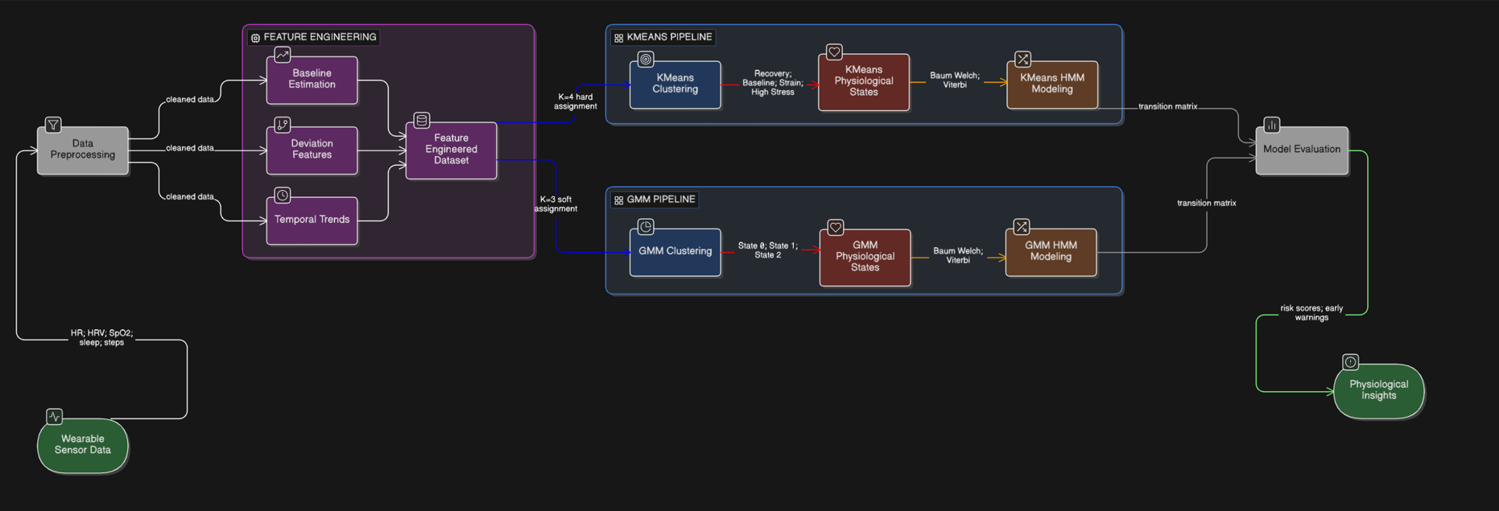
Flow Chart

Slide 14
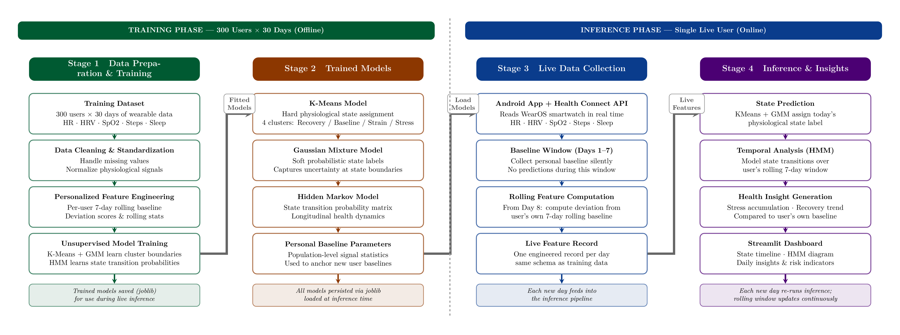
METHODOLOGY

Slide 15
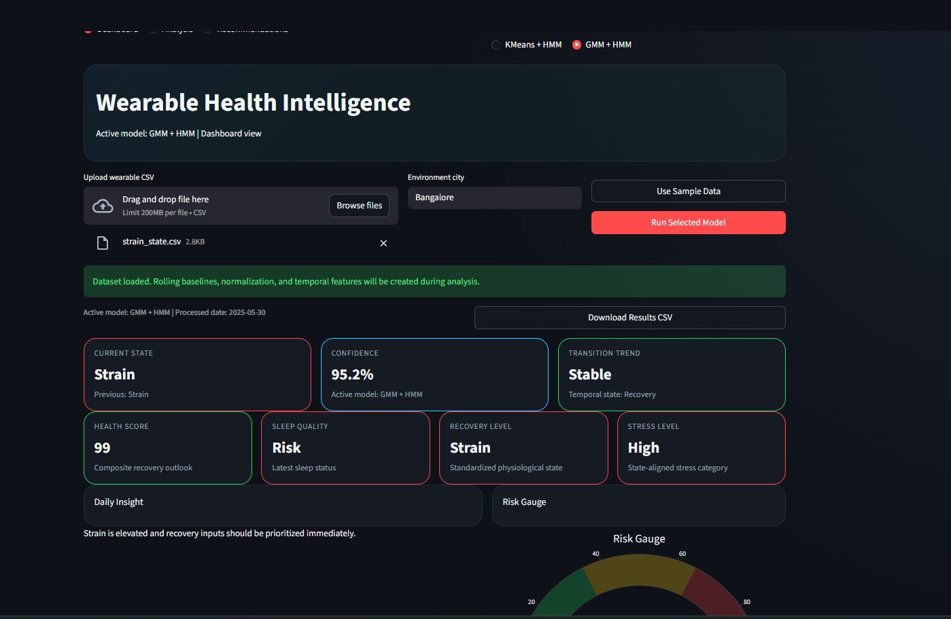
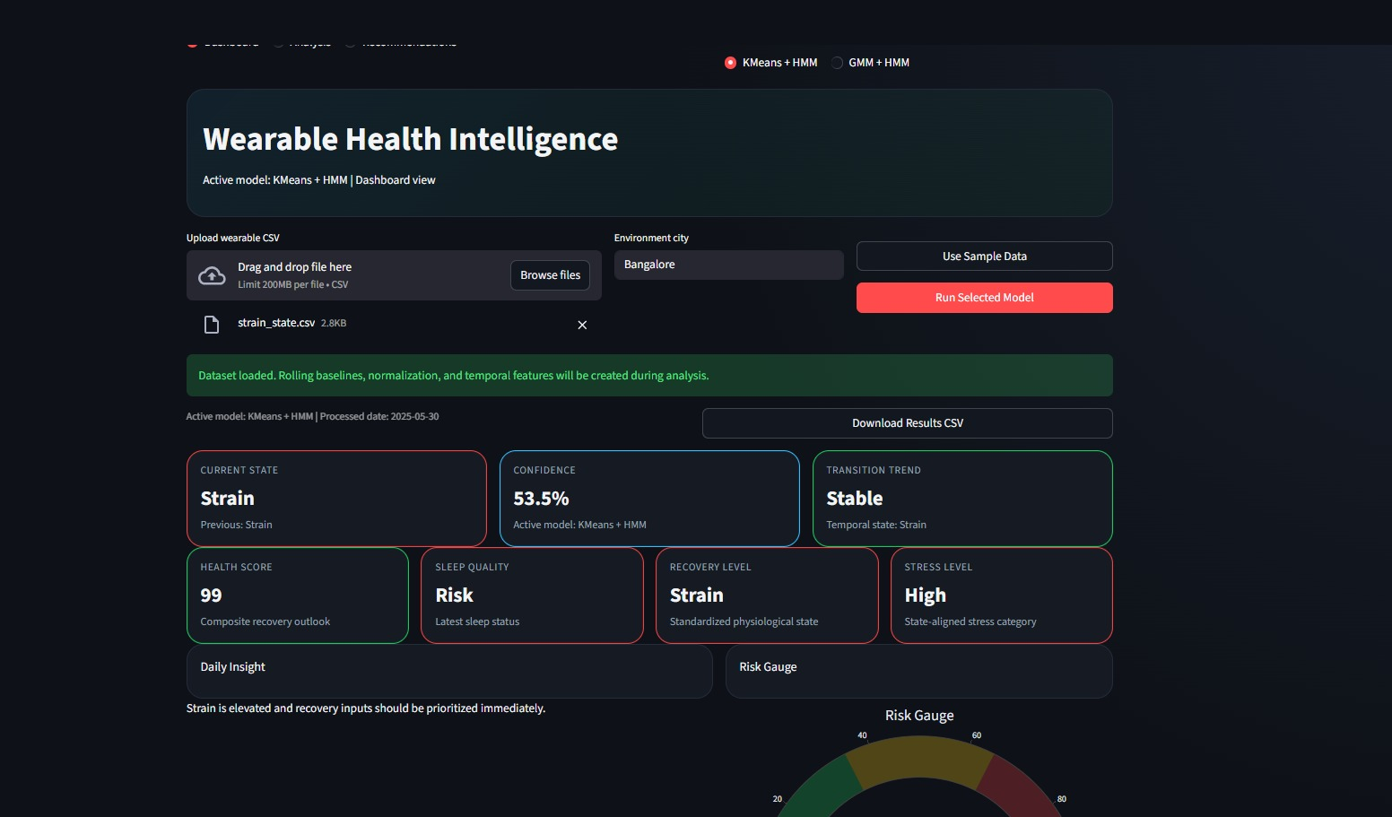
Output
GMM+HMM
Kmeans +HMM

Slide 16
References
[1] Learning Longitudinal Health Representations from EHR and Wearable Data. arXiv:2601.12227v1, 2026. https://arxiv.org/html/2601.12227v1
[2] AI on the Pulse: Real-Time Health Anomaly Detection with Wearable and Ambient Intelligence. arXiv:2508.03436v1, 2025. https://arxiv.org/html/2508.03436v1
[3] Passive Sensing for Mental Health Monitoring Using Machine Learning With Wearables and Smartphones: Scoping Review. Journal of Medical Internet Research (JMIR), 2025. https://www.jmir.org/2025/1/e77066
[4] Using Unsupervised Machine Learning to Characterize Recovery Patterns in Elite Canoe-Kayak Athletes Across the Olympic Training Year. Frontiers in Sports and Active Living, 2025. https://www.frontiersin.org/journals/sports-and-active-living/articles/10.3389/fspor.2025.1629924/full
[5] Hierarchical Heated Markov Modeling for Synthesizing Activity Data from Wearable Devices. PMC / NIH, 2025. https://pmc.ncbi.nlm.nih.gov/articles/PMC12810407/
[6] Predictive Modeling of Biomedical Temporal Data in Healthcare Applications: Review and Future Directions. PMC, 2025. https://pmc.ncbi.nlm.nih.gov/articles/PMC11519529/
[7] Resting Heart Rate Variability Measured by Consumer Wearables and Its Associations with Diverse Health Domains in Five Longitudinal Studies. MDPI Sensors 25(23):7147, 2025. https://pmc.ncbi.nlm.nih.gov/articles/PMC12693838/
[8] Physiological State Recognition via HRV and Fractal Analysis Using AI and Unsupervised Clustering. MDPI Information 16(9):718, 2025. https://www.mdpi.com/2078-2489/16/9/718
[9] AI on the Pulse: Real-Time Health Anomaly Detection — Wearable and Ambient Intelligence (XAI + LLM narrative layer). arXiv:2508.03436v1, 2025. https://arxiv.org/html/2508.03436v1
[10] Unsupervised Machine Learning Identifies Latent Ultradian States in Multi-Modal Wearable Sensor Signals. IEEE Xplore, 2025. https://ieeexplore.ieee.org/document/10871508/
[11] Heart Rate Variability Coefficient of Variation During Sleep as a Digital Biomarker Reflecting Behavior. American Journal of Physiology: Heart and Circulatory Physiology, 2025. https://journals.physiology.org/doi/10.1152/ajpheart.00738.2025
[12] SensorLM: Learning the Language of Wearable Sensors. Google Research Blog, 2025. https://research.google/blog/sensorlm-learning-the-language-of-wearable-sensors/
[13] Transformer-Driven Affective State Recognition from Wearable Physiological Data in Everyday Contexts. MDPI Sensors 25(3):761, 2025. https://www.mdpi.com/1424-8220/25/3/761
[14] Real-Time Physiological Activity and Sleep State Monitoring Using TS2Vec Embeddings and DBSCAN Clustering for Heart Rate and Motor Response Analysis in IoMT. MDPI Healthcare Technology, 2025. https://www.mdpi.com/2624-6120/6/4/67
[15] Gaussian Mixture Generative Model for Physiological State Identification in Wearable IoT Systems. Engineering Applications of Artificial Intelligence, Elsevier (S2665917424003775), 2024.

Slide 17

Thank you

